Slide 1
Secure Data Hiding in Image Using Steganography
CAPSTONE PROJECT
Presented By: Nanduri Neela Naga Sai
Student Name : Nanduri Neela Naga Sai
College Name & Department : DVR & DR.HS MIC College of Engineering and Technology

Slide 2
OUTLINE
Problem Statement
Technology used
Wow factor
End users
Result
Conclusion
Git-hub Link
Future scope

Slide 3
Problem Statement
Steganography involves embedding secret data within a digital image to ensure secure and imperceptible transmission. The problem is to develop a method that maximizes data hiding capacity while maintaining the image quality and ensuring robustness against detection and extraction attempts. The approach must balance between effective data concealment and minimal distortion of the original image. This method should also be computationally efficient and adaptable to various types of image formats.

Slide 4
Technology used
➔ Platform:
Python 3.19
VS Code (Extensions installed)
➔Libraries:
OpenCV: For image processing and manipulation.
NumPy: For handling and manipulating image arrays.
PIL (Pillow): For image handling and operations.
Cryptography: For encrypting and securing the hidden messages

Slide 5
Wow factors
Advanced Encoding Techniques: Utilizes cutting-edge steganographic algorithms to enhance data concealment without compromising image quality.
High-Capacity Data Embedding: Enables embedding of large amounts of data within images while maintaining the visual integrity of the image.
Robustness and Security: Ensures that the embedded data remains undetectable and resistant to various attacks, making it highly secure.
Multi-Format Adaptability: Supports various image formats, providing flexibility and ease of implementation across different platforms.
Computational Efficiency : Designed to be computationally efficient, ensuring fast processing and minimal resource consumption.

Slide 6
End users
Government and Intelligence Agencies: For securely transmitting classified information without drawing attention.
Businesses and Corporates: To protect sensitive information, trade secrets, and intellectual property.
Healthcare Institutions: For secure exchange of confidential patient data and medical records.
Law Enforcement Agencies: For discreet communication and protection of sensitive operational details.
Journalists and Whistleblowers: To safely share information without revealing sources.

Slide 7
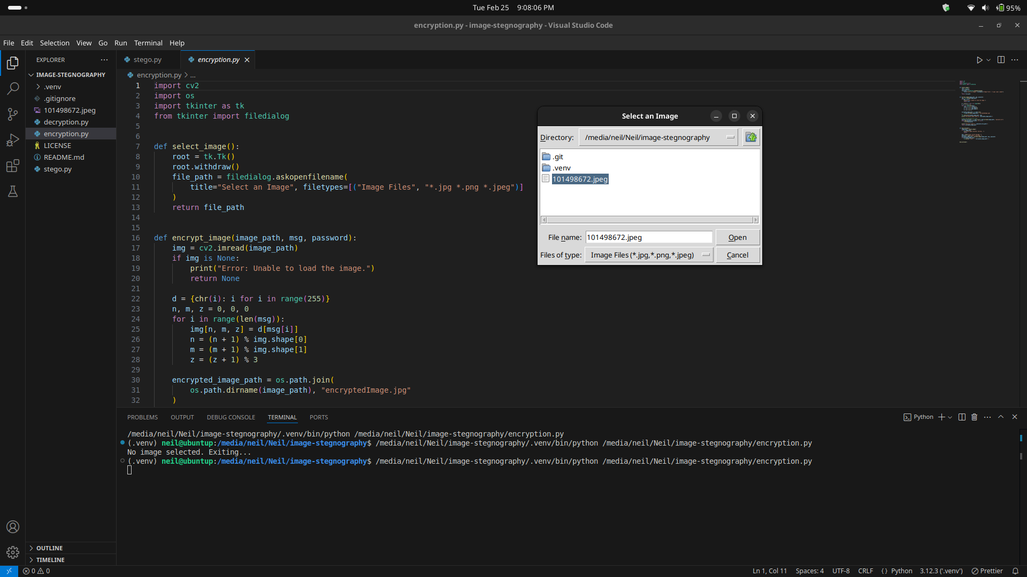
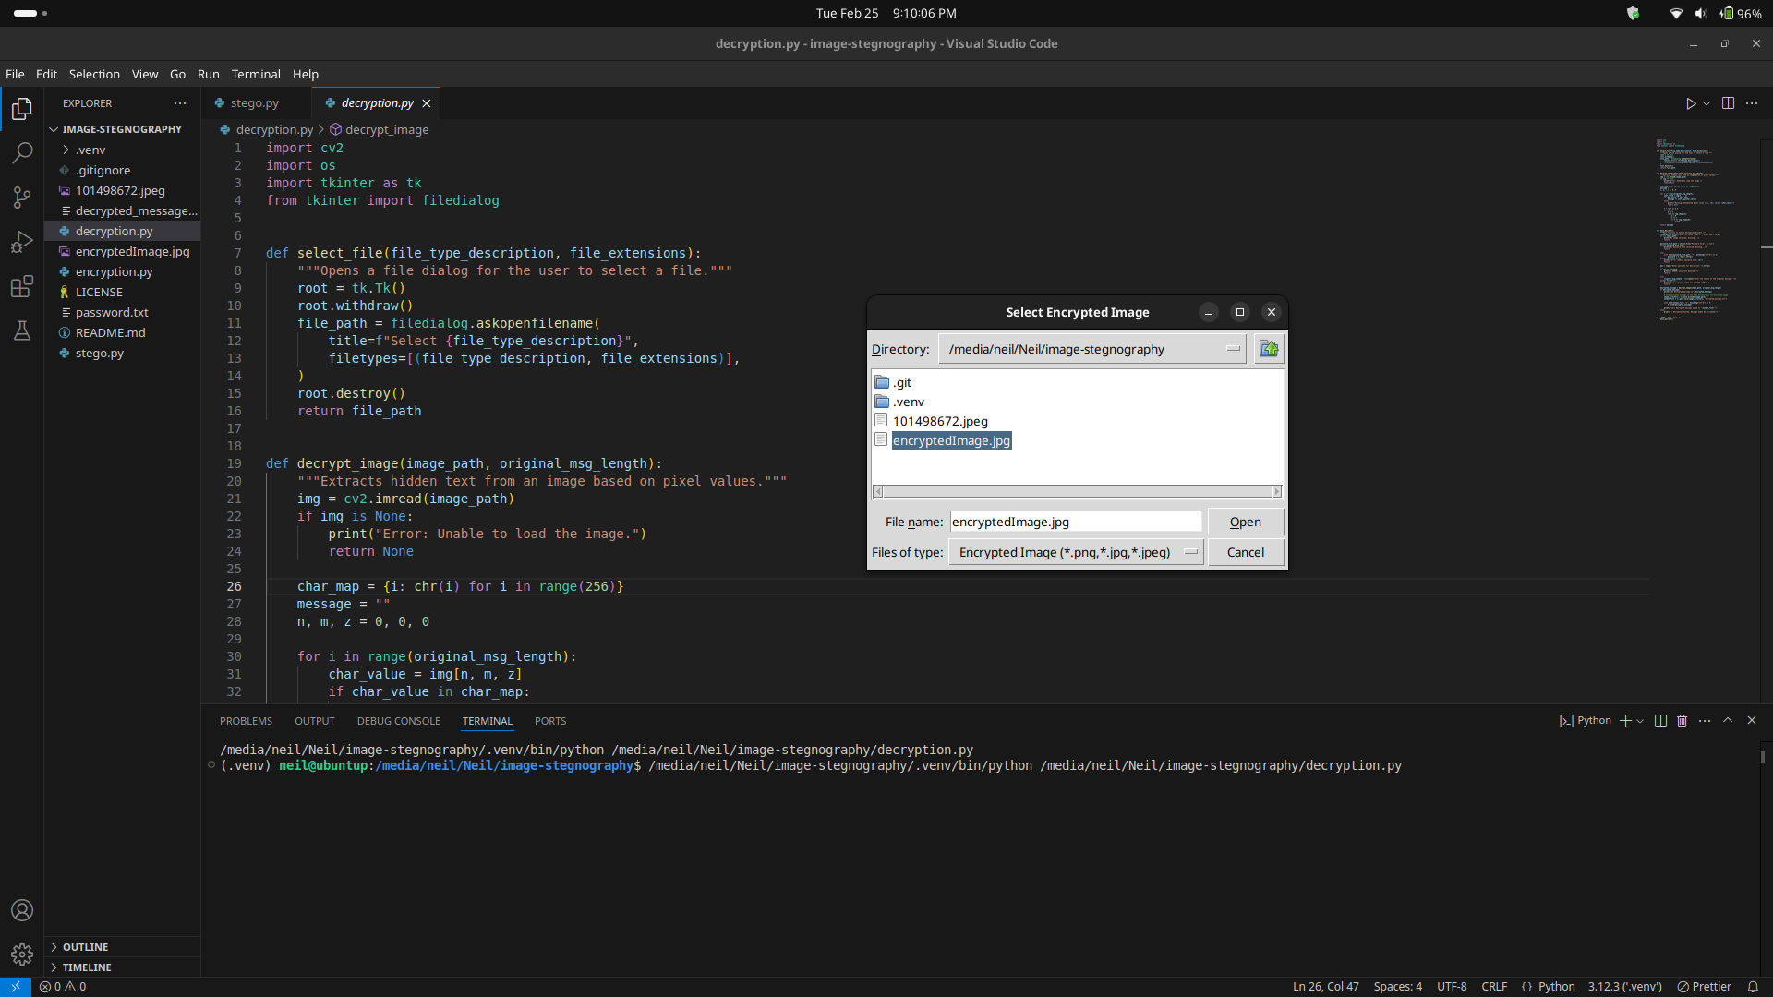
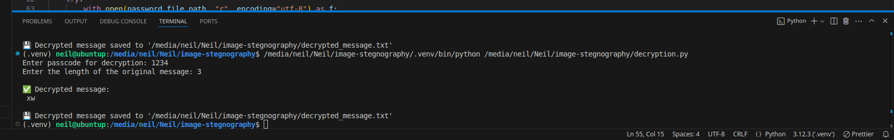
Results

Slide 8
Conclusion
The "Secure Data Hiding in Image Using Steganography" project offers a pioneering solution for covert communication and data protection. By leveraging advanced encoding techniques, high-capacity data embedding, and robust security features, it ensures that sensitive information remains undetectable and safe from unauthorized access. This project stands out due to its computational efficiency, adaptability to various image formats, and potential applications across multiple sectors such as government, business, healthcare, law enforcement, and journalism. Ultimately, this innovative approach to steganography represents a significant advancement in the field of data security.

Slide 9
GitHub Link
https://github.com/nagasainanduri/image-stegnography

Slide 10
THANK YOU

